Slide 1
Top 50 Cyberpunk art of all time · 3dtotal · Learn | Create | Share

Slide 2
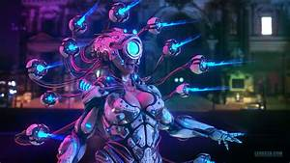
Experience these incredible visions of a cyberpunk future, brought to us by some of 3dtotal’s featured artists.

